Slide 1
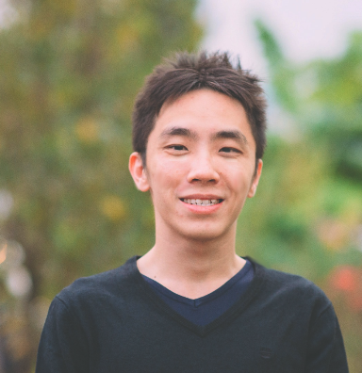

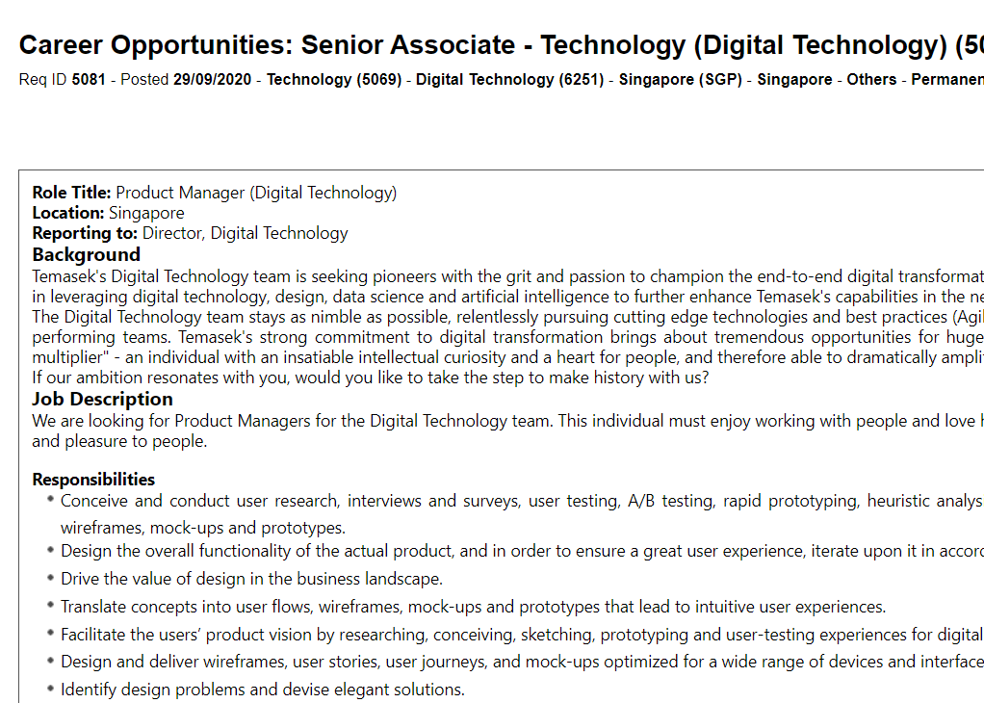
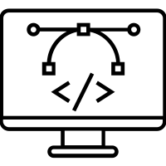


Hi, I’m Weilie.
Thank you for reviewing my application to the
Senior Associate (Digital Technology) role in Temasek Holdings.
I applied to this role because:
I am excited to build products that amplify users’ effectiveness in their work and sharpen their ability to deliver more economic and social impact. This role offers such an opportunity.
I believe my cross-training as UX researcher, developer and data scientist, and prior experience in enterprise development for deep-tech and R&D-driven companies, puts me in the sweet spot of technical mastery and domain knowledge that can best serve Temasek’s Digital Technology team and its users.
I bring the following to the table:
Product experience and skills in UX research, design and data science
Prior background in enterprise development, deep tech investment and R&D financing
A “people-first” disposition gleaned from deploying tech for social good
I have 3 years of UX, data science, development, and agile project management experience in Co-Lab, MOM’s in-house innovation unit. I:
Ask questions to scope innovation projects and ensure that we are in fact solving the right problems.
Conceptualise research approach, and lead interviews/ethnographies to understand pain points of users, from foreign workers to retirees.
Map their user journeys to identify points for intervention.
Run sprints to generate ideas and sacrificial concepts, prototype them using UI mockups, sketches, role-plays, or even code where necessary.
Develop machine learning models to predict needs and prioritise resources.
A/B test and pivot until success.
I am experienced in enterprise development and science & technology (S&T) investment work. In MTI, I worked on R&D/deep tech funding support. These duties share synergy with Temasek’s work. I:
Designed funding vehicles, e.g. grants and equity co-investment.
Actively sought and did due diligence on technology funding gaps (“valleys of death”) where private sector could not invest in.
Engaged company leaders from Fortune 500 C-suites to owners of local technology SMEs to understand their needs.
Brokered discussions between venture capital, STEM researchers, regulators to allay fears, reconcile interests and address commercialization gaps.
I forayed into innovation not for tech, but for people. Off-work, my passion lie in using tech to create impact in the social sector. I:
Redesigned a food rationing service that significantly impacted the charity landscape till today (see attached document in application). I scaled my social impact using tech (an Oracle app in this case) in tandem with a new service model.
Worked with persons with disabilities (PWDs) to design ride hailing UIs and solutions for daily tasks. I actively harnessed co-creation and facilitated inclusion to ensure that the tech solutions were relevant and could succeed.
TECHNICAL SKILL
DOMAIN KNOWLEDGE
DISPOSITION
My ability to straddle design and code in an agile environment equips me with the technical UX, development and PM skills to create force-multiplying solutions that empower Temasek’s business users.
Having done enterprise development and investment legwork myself (e.g. due diligence, structuring of funds), I can relate to your users’ jobs-to-be-done and pain points and meet them at their point of need more effectively.
To me, innovation is not only about tech, but also human dynamics and non-tech possibilities. This ethos has anchored me to always ensure that tech serves people and their mission, not vice versa.
My experiences put me in a unique place to contribute to the Temasek Digital Technology team. Thank you for reviewing my application once again.

